Slide 1

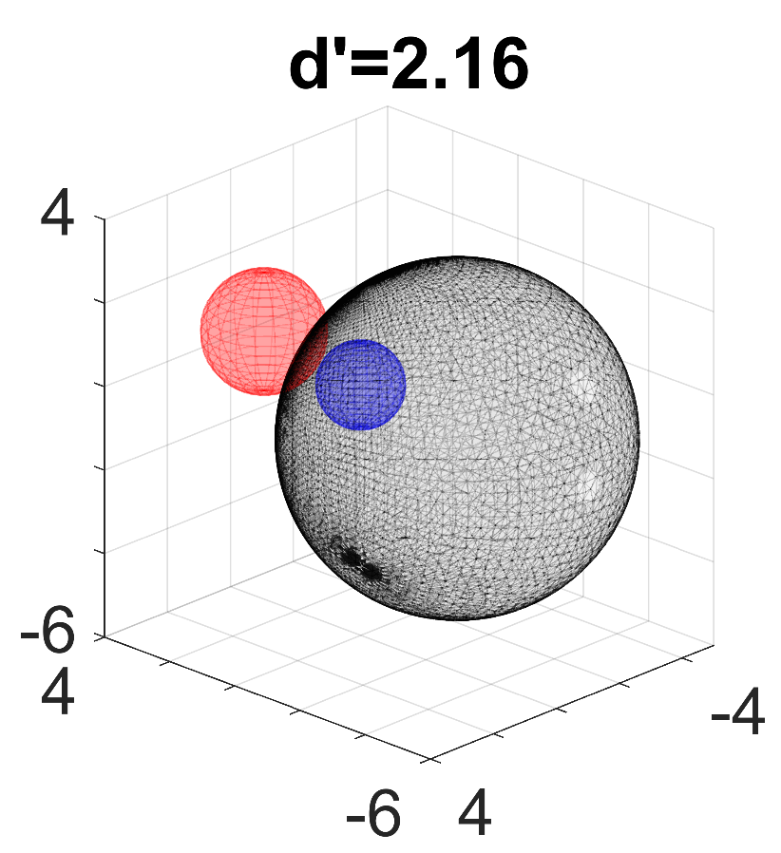
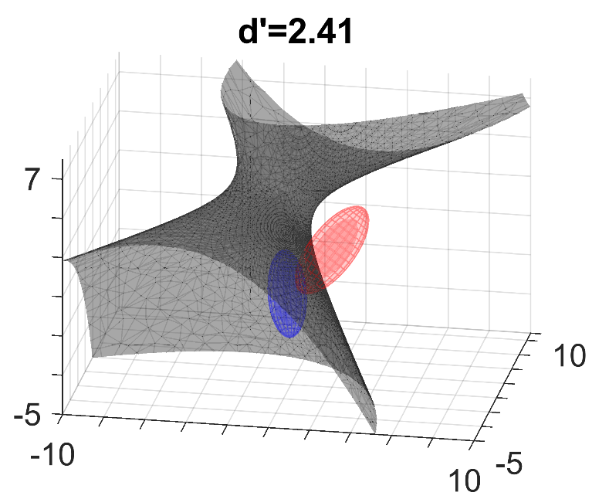
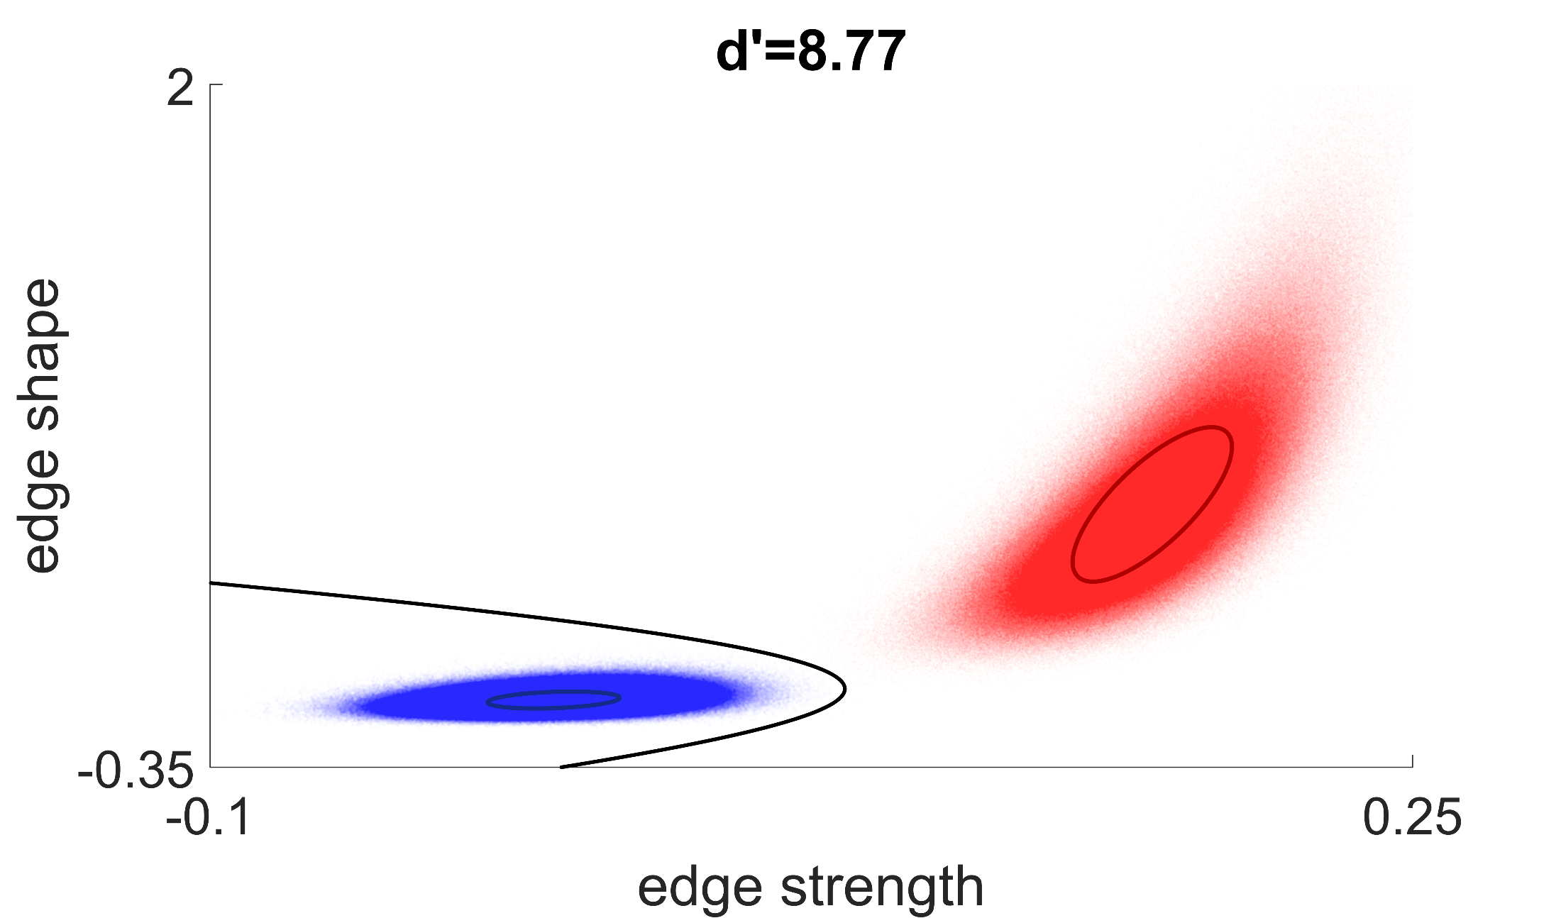
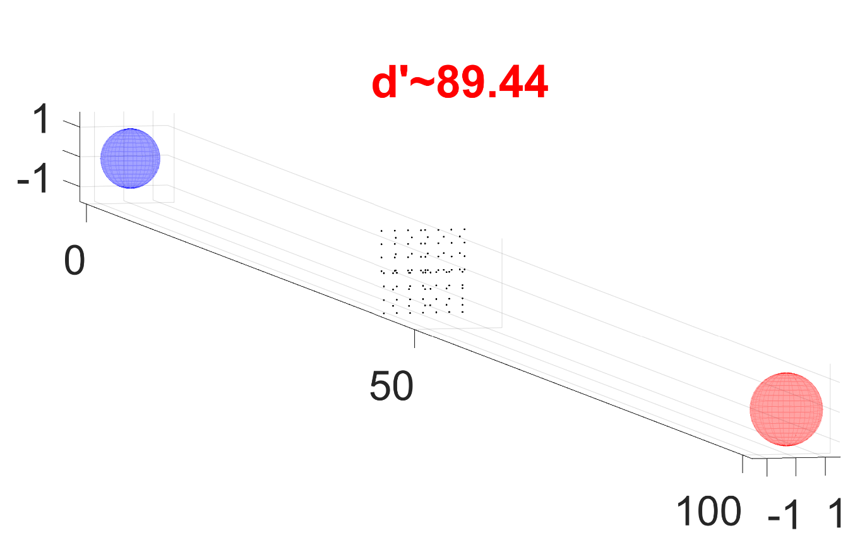

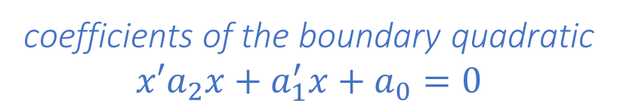
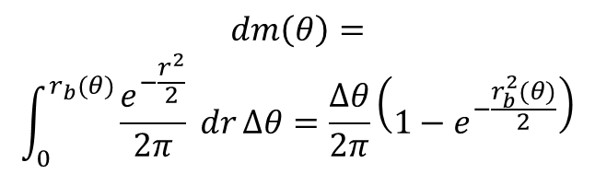
A new method to calculate classification accuracy
Abhranil Das, R Calen Walshe, Wilson Geisler · Center for Perceptual Systems · The University of Texas at Austin
Summary
A decision boundary can optimally classify observations into one of two Gaussians.
Accuracy is the fraction of the Gaussian masses in the correct decision regions.
b
Method
2. Use closed-form
radial integral
3. Sum radial integral over fixed angle grid
decision
region b
1. Whiten Gaussian
a
boundary
$$m=\sum_{θ}{dm(θ)}$$
decision
region a
The closed-form integral can be summed over a finite grid of angles that is the same in all cases.
These mass integrals have no closed form for general Gaussians. Standard numerical methods would be cumbersome, inaccurate and inefficient.
We present a solution that is fast, accurate and robust across cases.
Our MATLAB implementation is a complete suite of tools for such classification.
$$dm\left(θ\right)=$$
$$\int_{0}^{r_{b}(θ)}{\frac{e^{−\frac{r^{2}}{2}}}{2π} dr}Δθ=\frac{Δθ}{2π}\left(1−e^{−\frac{r_{b}^{2}(θ)}{2}}\right)$$
In polar form, the standard normal has a closed-form integral over a small angle within the boundary.
Example applications download our MATLAB toolbox from github.com/abhranildas/classify
Discriminate 1D Gaussians, unequal priors
Classification accuracy and d’ between Gaussians with specified parameters
>> mu_a=0; v_a=1;
>> mu_b=0.5; v_b=1.5;
>> results=classify([mu_a,v_a],[mu_b,v_b],'p_a',.7)
struct with fields:
acc_gauss: 0.7181
acc_gauss_a: 0.9634
acc_gauss_b: 0.1458
d_gauss: 0.4923
d_gauss_aprx: 0.4472
bd_pts_gauss_opt: [-3.7929 1.7929]
bd_coeffs_gauss_opt: struct with fields:
a2: -0.3333
a1: -0.6667
a0: 2.2667
Modify decision boundary
>> mu_a=[2 4]; v_a=[1 1.5; 1.5 3];
>> obs_a = mvnrnd(mu_a,v_a,100);
>> mu_b=[5 0]; v_b=[3 0; 0 1];
>> obs_b = mvnrnd(mu_b,v_b,100);
>> results=classify(obs_a,obs_b,'type','obs');
>> % modify boundary
>> custom_bd_coeffs=results.bd_coeffs_obs_opt;
>> custom_bd_coeffs.a2=custom_bd_coeffs.a2+.2;
>> custom_bd_coeffs.a1=custom_bd_coeffs.a1-5;
>> custom_bd_coeffs.a0=custom_bd_coeffs.a0+10;
>> results_mod=classify(obs_a,obs_b,'type','obs',...
'custom_bd_coeffs',custom_bd_coeffs);
optimal
boundary
accuracy
modified
boundary
discriminability d’
approx. d’
boundary pts
coefficients of the boundary quadratic
$${x′a}_{2}x+a_{1}^{′}x+a_{0}=0$$
Discriminate observations
Directly input observations instead of parameters
>> mu_a=0; v_a=1;
>> obs_a=normrnd(mu_a,sqrt(v_a),[1000 1]);
>> mu_b=2; v_b=1;
>> obs_b=normrnd(mu_b,sqrt(v_b),[2000 1]);
>> results=classify(obs_a,obs_b,'type','obs');
Discriminate 3D Gaussians
>> mu_a=[0;0;0];
>> v_a=eye(3);
>> mu_b=[2;1;1];
>> v_b=2*eye(3);
>> results=classify([mu_a,v_a],[mu_b,v_b]);
>> mu_a=[0;0;0];
>> v_a=[1 .5 0;
.5 2 1;
0 1 4];
>> mu_b=[2;1;2];
>> v_b=[2 1 -1.5;
1 3 -2;
-1.5 -2 4];
>> results=classify([mu_a,v_a],[mu_b,v_b]);
Discriminate 2D Gaussians
>> mu_a=[4; 5];
>> v_a=[2 1.1; 1.1 1];
>> mu_b=[4; 5];
>> v_b=1.4*v_a;
>> results=classify([mu_a,v_a],[mu_b,v_b]);
Real detection task data
Decision variables from an
actual camouflage
detection task.
>> load(‘camouflage_data.mat’, ...
’data_blank’,’data_target’)
>> results=classify(data_blank,...
data_target,'type','obs');
Estimate d’ between far-apart distributions
Get the approximate d’ even when
the overlap is too small to measure
(e.g. for ideal observers).
2
d’=8.77
edge shape
>> mu_a=[0;0;0]; v_a=eye(3);
>> mu_b=[100;0;0] v_b=1.5*eye(3);
>> results=classify([mu_a,v_a],[mu_b,v_b])
-0.35
-0.1
edge strength
0.25
Notes:
First column, second panel: dynamical equations changed from vector to index notation. There was also a mistake in the delta notation of spiking that had been pointed out to me in Cosyne, which has been fixed.
Second column, first panel: diffusion coefficient had been in units of rad^2/timestep. This has been changed to pattern wavelength^2/s.
In the third column, first panel, I switched the order of the plots. I think showing the trends of error vs data volume in the sensory and memory regimes helps motivate better why the optimal inference moves deeper into the sensory regime with increasing data.
For the legend of the data demand plot, I corrected the equation to be in terms of differences in data and weight strength. Otherwise we have a mistake as was pointed out by Birgit during my practice qualifier talk.

